Slide 1
General Principles of Level Design
Session 12

Slide 2
Outline Material
Introduction
Key design principles
Layout
Case Study

Slide 3
Introduction
Level design: constructing the experience for the player using components from the game designer
Level designers create:
Space in which the game takes place
Initial conditions of the level
Set of challenges within the level
Termination conditions of the level
Interplay between gameplay and story
Aesthetics and mood of the level

Slide 4
Key Design Principles
Universal level design principles
Make the early levels of a game tutorial levels
Vary the pacing of the level
When the player surmounts a challenge that consumes his resources, provide more resources
Avoid conceptual non sequiturs
Clearly inform the player of his short-term goals

Slide 5
Key Design Principles
Universal level design principles (cont.)
Be clear about risks, rewards, and consequences
Reward the player for skill, imagination, intelligence, and dedication
Reward in a large way, punish in a small way
Spend more resources (polygons, memory, CPU time) on the foreground than on the background
The purpose of an artificial opponent is to put up a good fight and then lose
Implement multiple difficulty settings

Slide 6
Key Design Principles
Genre-specific level design principles
Action game—vary the pace
Strategy game—reward planning
Role-playing game—offer opportunities for character growth and player self-expression
Sports game—verisimilitude is vital
Vehicle simulation—reward skillful maneuvering

Slide 7
Key Design Principles
Genre-specific level design principles (cont.)
Construction and management simulation—offer an interesting variety of initial conditions and goals
Adventure game—construct challenges that harmonize with their locations and the story
Artificial life game—create many interaction opportunities for the creatures in their environment
Puzzle game—give the player time to think

Slide 8
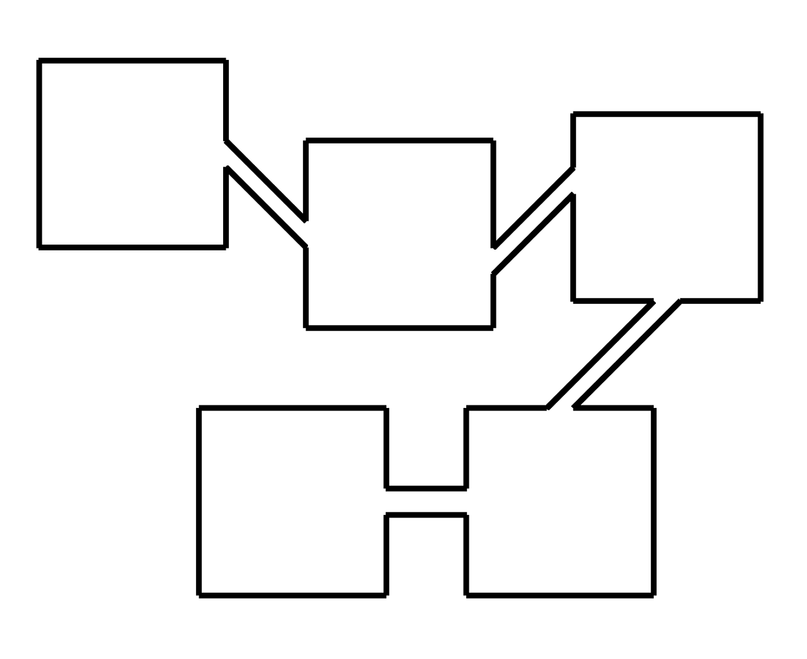
Layout
Open layouts
Allow unconstrained movement
Correspond to the outdoors
Used in war games and role-playing games
Linear layouts
Require player to move in a fixed sequence
Player can move only to next or previous area
Used traditionally in side-scrolling action games and rail-shooters

Slide 9
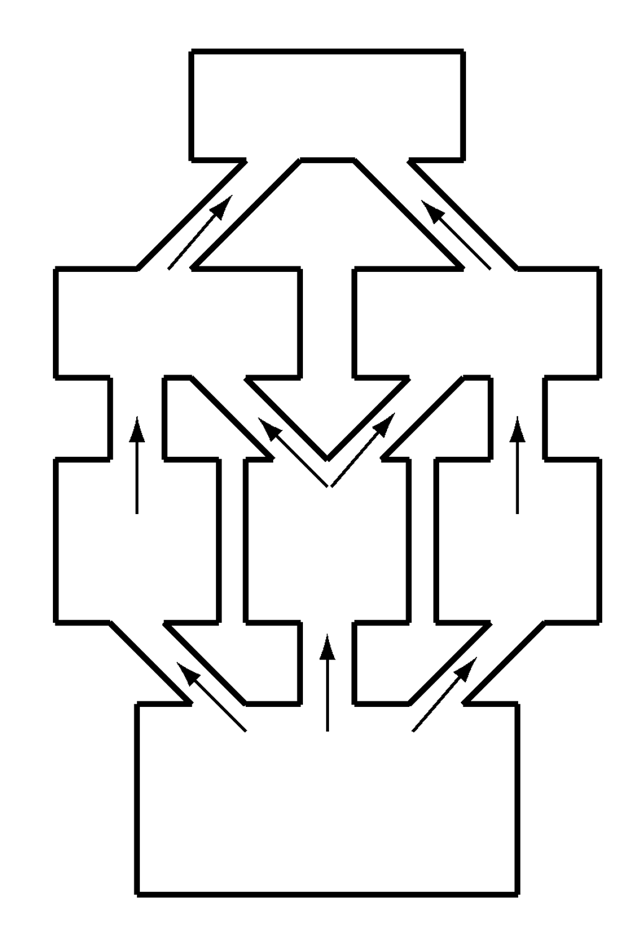
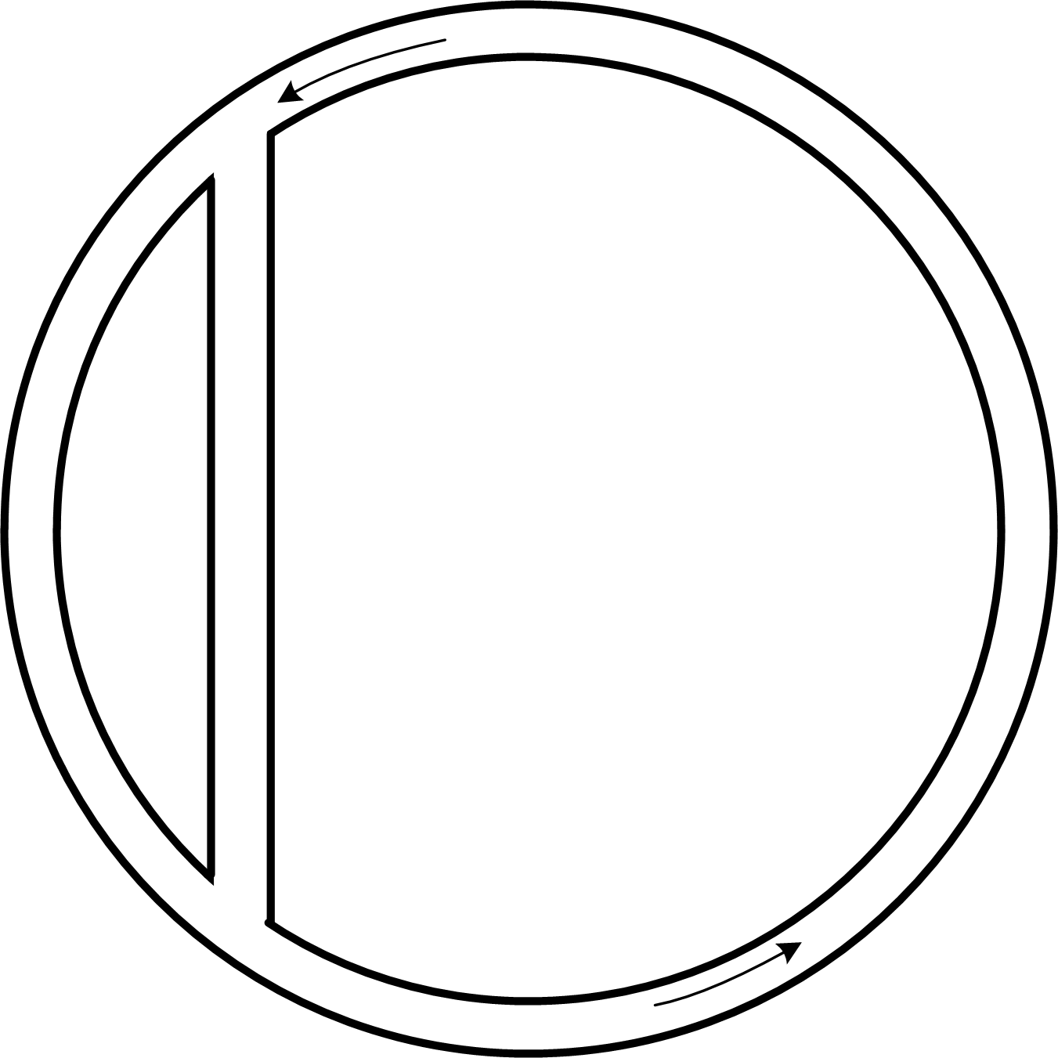
Layout
Parallel layouts
Modern variant of linear layouts
Variety of paths can go through the level
Can reflect a foldback story structure
Ring layouts
Path returns to its starting point
Oval tracks or twisting road-racing tracks are rings
Used for racing games

Slide 10
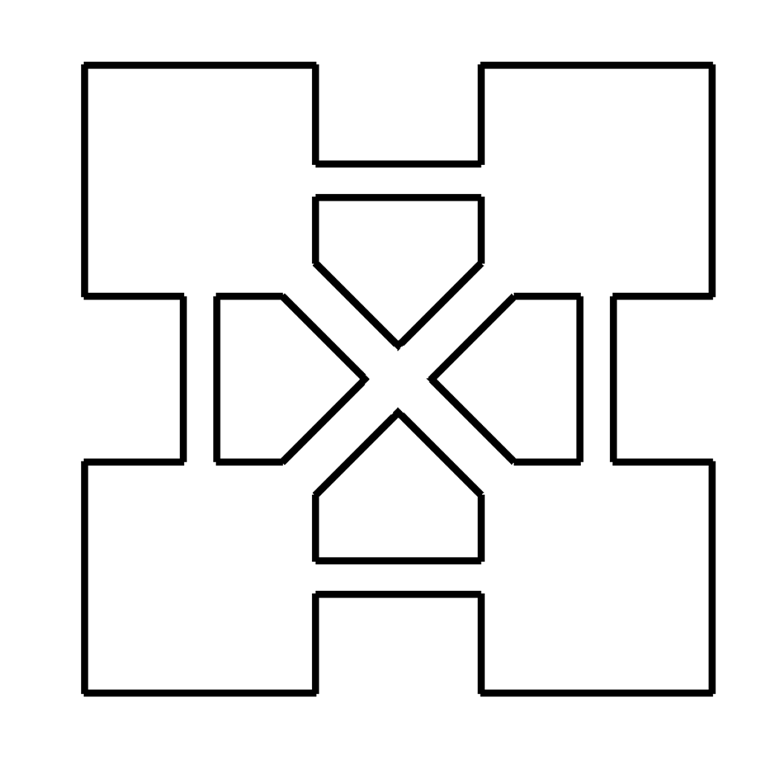
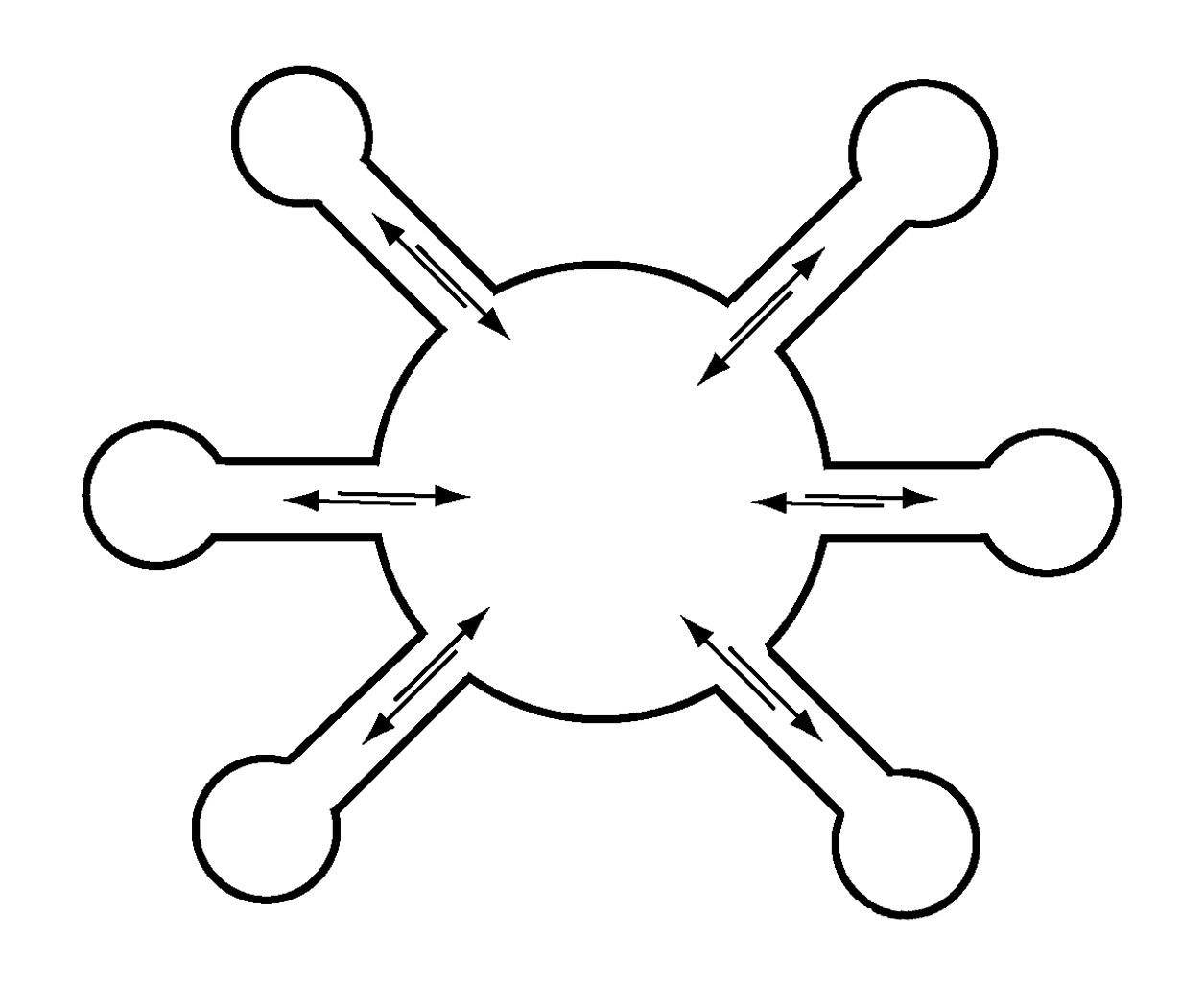
Layout
Network layouts
Spaces connect to other spaces in different ways
Give the player freedom to take any path
Stories must be able to tolerate player experiencing events in any sequence
Hub-and-spoke layouts
Central hub is usually a safe zone
Provides some choice of where to go
Lock off some areas to control sequence a little

Slide 11
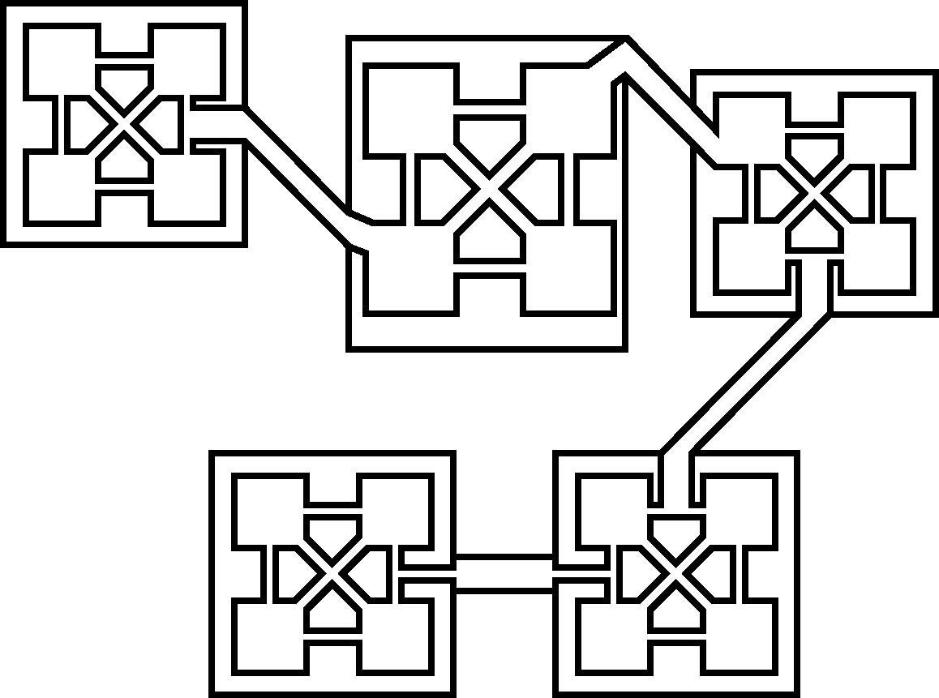
Layout
Combinations of layouts
Combines aspects of several layout types
Role-playing games and adventure games often use combination layouts

Slide 12
Case Study
Make the level design of your game

